Slide 1
Bits, Bytes, and Integers
60080013: Computer Organization
2nd Lecture
Instructors:
Sun Heng

Slide 2
Encoding Byte Values
Decimal
Hex
Binary
Byte = 8 bits
  Binary 00000000₂ to 11111111₂
  Decimal: 0₁₀ to 255₁₀
  Hexadecimal 00₁₆ to FF₁₆
    Base 16 number representation
    Use characters ‘0’ to ‘9’ and ‘A’ to ‘F’
    Write FA1D37B₁₆ in C as 0xFA1D37B
      Or 0xfa1d37b
0
0
0000
1
1
0001
2
2
0010
3
3
0011
4
4
0100
5
5
0101
6
6
0110
7
7
0111
8
8
1000
9
9
1001
A
10
1010
B
11
1011
C
12
1100
D
13
1101
E
14
1110
F
15
1111

Slide 3
Hexadecimal vs. Binary
0x173A4C
Hexadecimal 1 7 3 A 4 C
Binary 0001 0111 0011 1010 0100 1100
1111001010110110110011
Binary 11 1100 1010 1101 1011 0011
Hexadecimal 3 C A D B 3
0x3CADB3
Notes:
W 87

Slide 4
Byte-Oriented Memory Organization
00•••0
FF•••F
• • •
Programs Refer to Virtual Addresses
  Conceptually very large array of bytes
Every byte of memory is identified by a unique number, known as its address
  Set of all possible addresses is known as the virtual address space.

Slide 5
Machine Words
Machine Has “Word Size”
  Nominal size of integer-valued data
    Including addresses
  Previous machines use 32 bits (4 bytes) words
    Limits addresses to 4GB
    Becoming too small for memory-intensive applications
  Modern systems use 64 bits (8 bytes) words
    Potential address space ≈ 1.8 X 10¹⁹ bytes

Slide 6
Machine Words
Let a machine with a w-bit word size,
its virtual addresses ∈ [0, 2^{w − 1}].

Slide 7
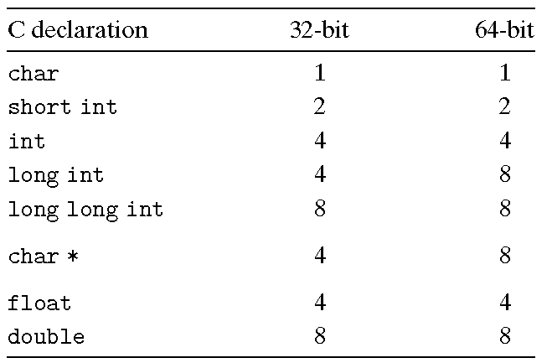
Data Representations
Computers and compilers support multiple data formats using different ways to encode data, such as integers and floating point, as well as different lengths.

Slide 8
Byte Ordering
How should bytes within a multi-byte word be ordered in memory?
In virtually all machines, a multi-byte object is stored as a contiguous sequence of bytes, with the address of the object given by the smallest address of the bytes used. For example, suppose a variable x of type int has address 0x100; that is, the value of the address expression &x is 0x100. Then the 4 bytes of x would be stored in memory locations 0x100, 0x101, 0x102, and 0x103.

Slide 9
Byte Ordering
Conventions
  Big Endian: Sun, IBM
    Least significant byte has highest address
  Little Endian: x86
    Least significant byte has lowest address

Slide 10
Byte Ordering Example
Big Endian
  Least significant byte has highest address
Little Endian
  Least significant byte has lowest address
Example
  Variable x has 4-byte representation 0x01234567
  Address given by &x is 0x100
Big Endian
0x100
0x101
0x102
0x103
01
23
45
67
01
23
45
67
Little Endian
0x100
0x101
0x102
0x103
67
45
23
01
67
45
23
01

Slide 11
Reading Byte-Reversed Listings
Disassembly
  Text representation of binary machine code
  Generated by program that reads the machine code
Example Fragment
Deciphering Numbers
  Value: 0x12ab
  Reverse: 00 00 12 ab
Address Instruction Code Assembly Rendition
8048365: 5b pop %ebx
8048366: 81 c3 ab 12 00 00 add $0x12ab,%ebx
804836c: 83 bb 28 00 00 00 00 cmpl $0x0,0x28(%ebx)

Slide 12
Examining Data Representations
Code to Print Byte Representation of Data
  Casting pointer to unsigned char * creates byte array
typedef unsigned char *byte_pointer;
void show_bytes(byte_pointer start, int len){
int i;
for (i = 0; i<len; i++)
printf(”%.2x", start[i]);
printf("\n");
}
Printf directives:
%x: Print Hexadecimal

Slide 13
show_bytes Execution Example
int a = 12345;
show_bytes((pointer) &a, sizeof(int));
Result (Linux):
39 30 00 00

Slide 14
Representing Strings
Strings in C
  Represented by array of characters
  Each character encoded in ASCII format
    Standard 7-bit encoding of character set
    Character “0” has code 0x30
      Digit i has code 0x30+i
  String should be null-terminated
    Final character = 0
Compatibility
  Byte ordering not an issue
char S[6] = "12345";
Linux
Sun
31
32
33
34
35
00
31
32
33
34
35
00

Slide 15
Boolean Algebra
Since binary values are at the core of how computers encode, store, and manipulate information, a rich body of mathematical knowledge has evolved around the study of the values 0 and 1. This started with the work of George Boole around 1850 and thus is known as Boolean algebra.

Slide 16
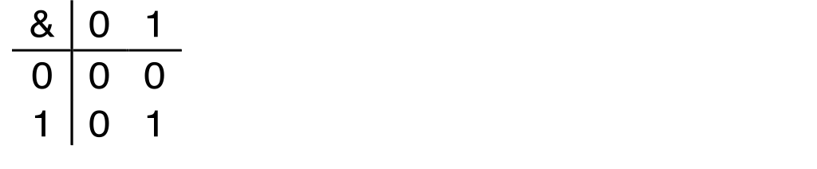
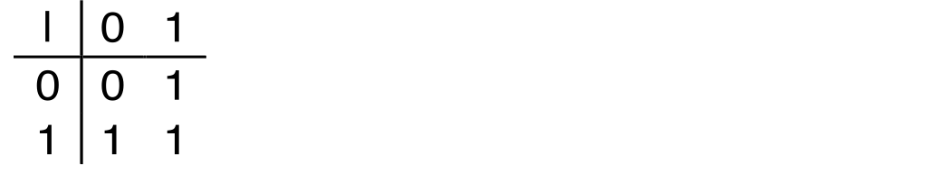
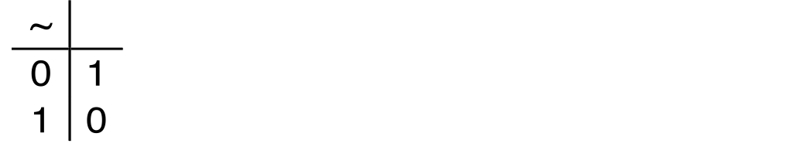
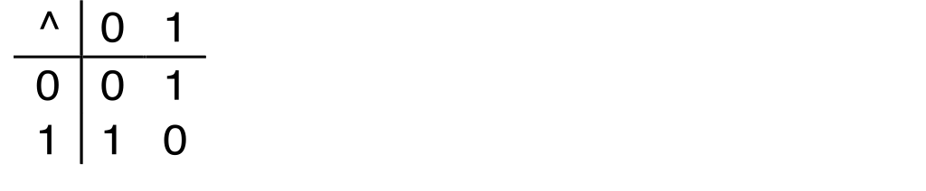
Boolean Algebra
Developed by George Boole in 19th Century
  Algebraic representation of logic
    Encode “True” as 1 and “False” as 0
And
A&B = 1 when both A=1 and B=1
Or
A|B = 1 when either A=1 or B=1
Not
~A = 1 when A=0
Exclusive-Or (Xor)
A^B = 1 when either A=1 or B=1, but not both

Slide 17
General Boolean Algebras
Operate on Bit Vectors
  Operations applied bitwise
01101001
& 01010101
01000001
01101001
| 01010101
01111101
01101001
^ 01010101
00111100
~ 01010101
10101010
01000001
01111101
00111100
10101010

Slide 18
Representing & Manipulating Sets
Representation
  Width w bit vector represents subsets of {0, …, w–1}
  a_{j} = 1 if j ∈ A
    01101001 { 0, 3, 5, 6 }
    76543210
    01010101 { 0, 2, 4, 6 }
    76543210
Operations
  & Intersection 01000001 { 0, 6 }
  | Union 01111101 { 0, 2, 3, 4, 5, 6 }
  ^ Symmetric difference 00111100 { 2, 3, 4, 5 }
  ~ Complement 10101010 { 1, 3, 5, 7 }

Slide 19
Shift Operations
Argument x
01100010
Left Shift: x << y
  Shift bit-vector x left y positions
    Throw away extra bits on left
    Fill with 0’s on right
x is shifted k bits to the left, dropping off the k most significant bits and filling the right end with k zeros.
<< 3
00010000
00010000
00010000
Argument x
10100010
<< 3
00010000
00010000
00010000

Slide 20
Shift Operations
Right Shift: x >> y
  Shift bit-vector x right y positions
    Throw away extra bits on right
  Logical shift
    Fill with 0’s on left
  Arithmetic shift
    Replicate most significant bit on left
Argument x
01100010
Log. >> 2
00011000
00011000
00011000
Arith. >> 2
00011000
00011000
00011000
Argument x
10100010
Log. >> 2
00101000
00101000
00101000
Arith. >> 2
11101000
11101000
11101000

Slide 21
Classwork
Problem 2.5, 2.8, and 2.16.

Slide 22
Encoding Integers
In this part, we describe two different ways where bits can be used to encode integers.
  One is unsigned encoding that can only represent nonnegative numbers.
  The other is two’s-complement encoding that can represent negative, zero, and positive numbers.

Slide 23
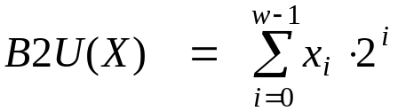
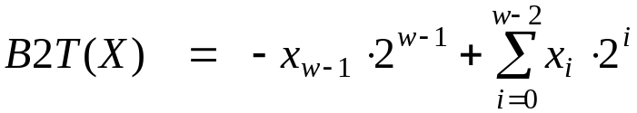
Encoding Integers
Unsigned
Two’s Complement
Sign
Bit
Sign Bit
  For 2’s complement, most significant bit indicates sign
    0 for nonnegative
    1 for negative

Slide 24
Numeric Ranges
Unsigned Values
  UMin = 0
    000…0
  UMax = 2^{w} – 1
    111…1
Two’s Complement Values
  TMin = –2^{w–1}
    100…0
  TMax = 2^{w–1} – 1
    011…1

Slide 25
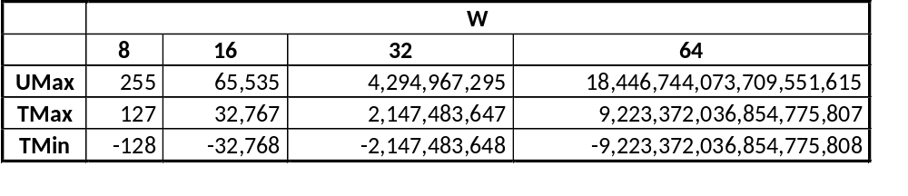
Values for Different Word Sizes
Observations
  |TMin|= TMax + 1 (Asymmetric range)
  UMax = 2 * TMax + 1

Slide 26
Mapping Between Signed & Unsigned
Two’s Complement
Unsigned
T2U
x
T2B
B2U
ux
X
Maintain Same Bit Pattern
Unsigned
U2T
Two’s Complement
ux
U2B
B2T
x
X
Maintain Same Bit Pattern
Mappings between unsigned and two’s complement numbers:
keep bit representations and reinterpret

Slide 27
Bits
0000
0001
0010
0011
0100
0101
0110
0111
1000
1001
1010
1011
1100
1101
1110
1111
Signed
0
1
2
3
4
5
6
7
-8
-7
-6
-5
-4
-3
-2
-1
Unsigned
0
1
2
3
4
5
6
7
8
9
10
11
12
13
14
15
T2U
U2T

Slide 28

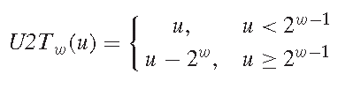
Bits
0000
0001
0010
0011
0100
0101
0110
0111
1000
1001
1010
1011
1100
1101
1110
1111
Signed
0
1
2
3
4
5
6
7
-8
-7
-6
-5
-4
-3
-2
-1
Unsigned
0
1
2
3
4
5
6
7
8
9
10
11
12
13
14
15
=
+/- 16

Slide 29
Signed vs. Unsigned in C
Constants
  By default are considered to be signed integers
  Unsigned if have “U” as suffix
    0U, 4294967259U
Casting
  casting between signed & unsigned same as U2T and T2U
    int tx, ty;
    unsigned ux, uy;
    tx = (int) ux;
    uy = (unsigned) ty;

Slide 30
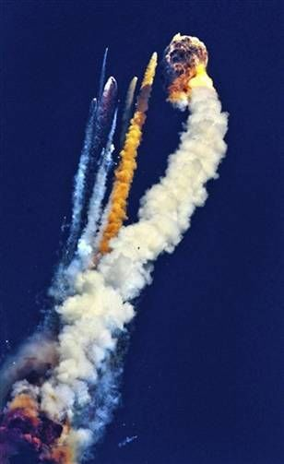
What Went Wrong?
On June 4, 1996 an unmanned Ariane 5 rocket launched by the European Space Agency exploded just forty seconds after its lift-off from Kourou, French Guiana. The rocket was on its first voyage, after a decade of development costing $7 billion. The destroyed rocket and its cargo were valued at $500 million. A board of inquiry investigated the causes of the explosion and in two weeks issued a report. It turned out that the cause of the failure was a software error in the inertial reference system. Specifically a 64 bit floating point number relating to the horizontal velocity of the rocket with respect to the platform was converted to a 16 bit signed integer. The number was larger than 32,767, the largest integer storable in a 16 bit signed integer, and thus the conversion failed.

Slide 31
Sign Extension
One common operation is to convert between integers having different word sizes while retaining the same numeric value. Of course, this may not be possible when the destination data type is too small to represent the desired value. Converting from a smaller to a larger data type, however, should always be possible.

Slide 32
Sign Extension
Task:
  Given w-bit signed integer x
  Convert it to w+k-bit integer with same value
Rule:
  Make k copies of sign bit:
  X′ = x_{w–1} ,…, x_{w–1} , x_{w–1} , x_{w–2} ,…, x₀
k copies of MSB
w
X
• • •
• • •
X′
• • •
• • •
k
w

Slide 33
Truncating: Basic Rules
Suppose that, rather than extending a value with extra bits, we reduce the number of bits representing a number. Truncating a number can alter its value—a form of overflow.

Slide 34
Truncating: Basic Rules
Truncating (e.g., unsigned to unsigned short)
  Unsigned/signed: bits are truncated
    Unsigned: mod operation
    Signed: similar to mod
  For small numbers yields expected behaviour

Slide 35

Unsigned Addition
u
Operands: w bits
• • •
+
v
• • •
True Sum: w+1 bits
u + v
• • •
Discard Carry: w bits
UAdd_{w}(u , v)
• • •
Standard Addition Function
  Ignores carry output
Implements Modular Arithmetic
  s = UAdd_{w}(u , v) = u + v mod 2^{w}

Slide 36
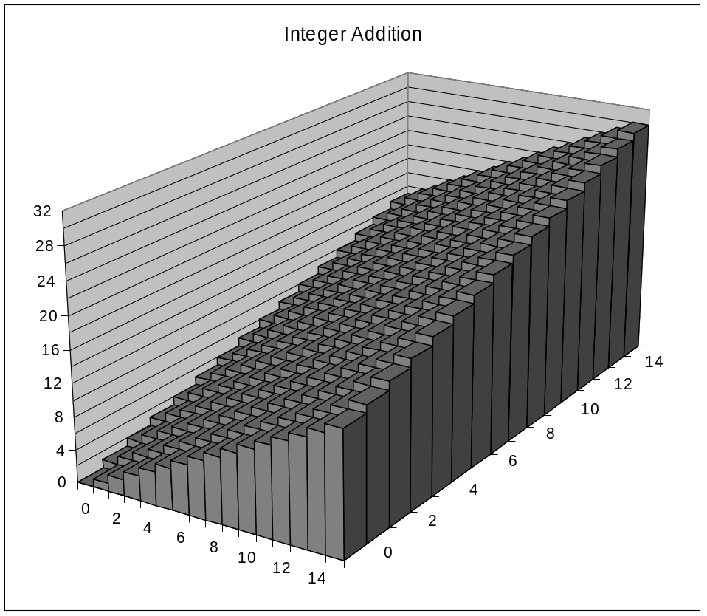
Visualizing (Mathematical) Integer Addition
Integer Addition
  4-bit integers u, v
  Compute true sum Add₄(u , v)
  Values increase linearly with u and v
  Forms planar surface
Add₄(u , v)
v
u

Slide 37
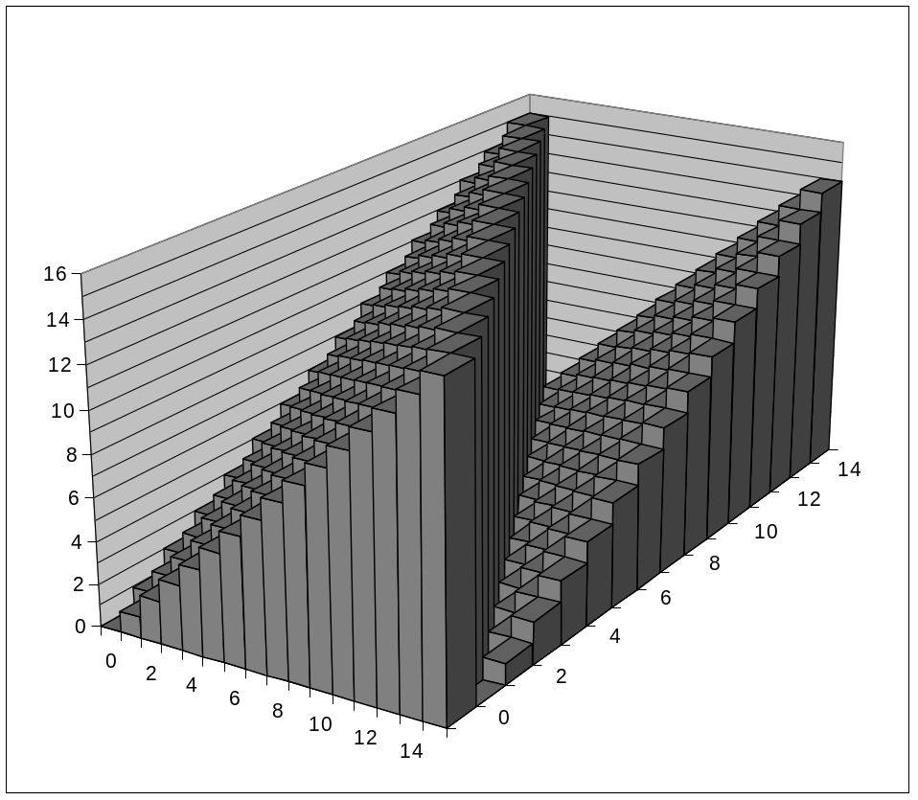
Visualizing Unsigned Addition
Wraps Around
  If true sum ≥ 2^{w}
  At most once
Overflow
UAdd₄(u , v)
True Sum
2^{w+1}
Overflow
2^{w}
v
0
Modular Sum
u

Slide 38

Two’s Complement Addition
Positive Overflow
Functionality
  True sum requires w+1 bits
  Treat remaining bits as 2’s comp. integer
TAdd(u , v)
> 0
v
< 0
< 0
> 0
u
Negative Overflow
2^{w}
(NegOver)
2^{w}
(PosOver)

Slide 39

Unsigned Multiplication in C
u
• • •
Operands: w bits
*
v
• • •
True Product: 2*w bits
u · v
• • •
UMult_{w}(u , v)
Discard w bits: w bits
• • •
Standard Multiplication Function
  Ignores high order w bits
Implements Modular Arithmetic
  UMult_{w}(u , v) = u · v mod 2^{w}

Slide 40
Signed Multiplication in C
u
• • •
Operands: w bits
*
v
• • •
True Product: 2*w bits
u · v
• • •
• • •
TMult_{w}(u , v)
Discard w bits: w bits
• • •
Standard Multiplication Function
  Ignores high order w bits
  Some of which are different for signed vs. unsigned multiplication
  Lower bits are the same
  TMult_{w}(u , v) = U2T_{w} ((u · v) mod 2^{w})

Slide 41
Power-of-2 Multiply with Shift
On most machines, the integer multiply instruction was fairly slow, requiring 10 or more clock cycles, whereas other integer operations — such as addition, subtraction, bit-level operations, and shifting — required only 1 clock cycle. As a consequence, one important optimization used by compilers is to attempt to replace multiplications by constant factors with combinations of shift and addition operations.

Slide 42
Power-of-2 Multiply with Shift
Operation
  u << k gives u * 2^{k}
  Both signed and unsigned
k
u
• • •
Operands: w bits
*
2^{k}
0
•••
0
1
0
•••
0
0
True Product: w+k bits
u · 2^{k}
• • •
0
•••
0
0
Discard k bits: w bits
UMult_{w}(u , 2^{k})
•••
0
•••
0
0
TMult_{w}(u , 2^{k})

Slide 43
Unsigned Power-of-2 Divide with Shift
Integer division on most machines is even slower than integer multiplication — requiring 30 or more clock cycles. Dividing by a power of 2 can also be performed using shift operations, but we use a right shift rather than a left shift. The two different right shifts — logical and arithmetic — serve this purpose for unsigned and two’s-complement numbers, respectively.

Slide 44
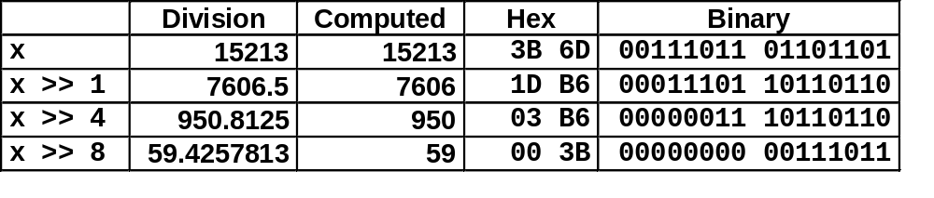
Unsigned Power-of-2 Divide with Shift
Quotient of Unsigned by Power of 2
  u >> k gives ⎣ u / 2^{k} ⎦
  Uses logical shift
Round Down label
k
u
•••
•••
Binary Point
Operands:
/
2^{k}
0
•••
0
1
0
•••
0
0
Division:
u / 2^{k}
0
.
0
•••
0
0
•••
•••
Result:
⎣ u / 2^{k} ⎦
0
0
•••
0
0
•••

Slide 45
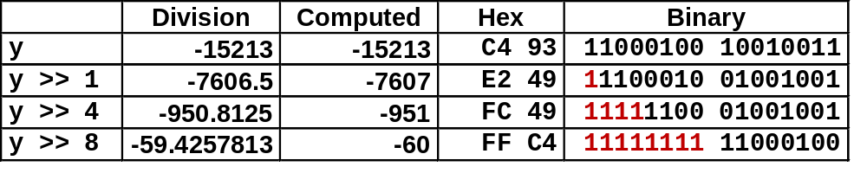
Signed Power-of-2 Divide with Shift
Quotient of Signed by Power of 2
  y >> k gives ⎣ y / 2^{k} ⎦
  Uses arithmetic shift
  Rounds wrong direction when y < 0
k
y
•••
•••
Binary Point
Operands:
/
2^{k}
0
•••
0
1
0
•••
0
0
Division:
y / 2^{k}
0
•••
•••
.
•••
Result:
RoundDown(y / 2^{k})
0
•••
•••

Slide 46
Classwork
Problem 2.17 & 2.40.

